Slide 1
Development of Reconciliation Strategies for Large Bulk Water Supply Systems of the Luvuvhu and Letaba Water Supply System
Study Steering Committee Meeting No 4
21 November 2013
Continuation of the Olifants River Reconciliation Strategy
(Item 10.4)

Slide 2
Olifants Reconciliation Strategy: Overview
A Strategy was developed and completed in 2012
Currently in the first phase of implementation and maintenance of the Strategy
Strategy provide for:
the implementation of the Reserve,
continued water supply from adjacent catchments for power generation, and
supply to Polokwane and Mokopane from the Olifants River

Slide 3
Olifants Reconciliation Strategy: Interventions
Strategy aims at reconciliation future demands and supplies by:
Eliminating unlawful water use
Introducing water conservation and water demand management (WC/WDM) in all sectors
Utilisation of treated acid mine drainage water
Removing of invasive alien plants
Developing groundwater
Additional reuse of return flows from Polokwane and Mokopane

Slide 4
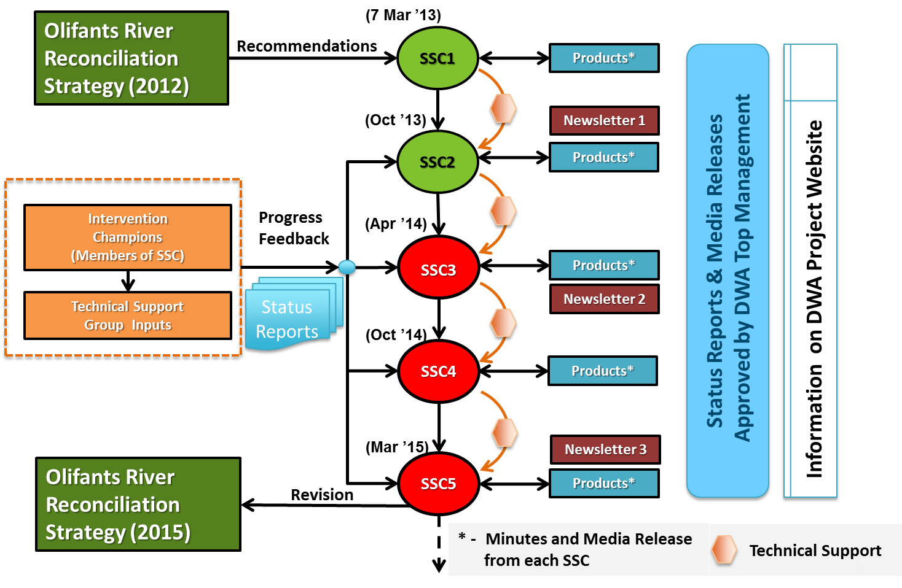
Olifants Reconciliation Strategy: Status

Slide 5
Olifants Reconciliation Strategy: Achievements
Incorporate recent coal mine development planning and assess implication on water balances
Calibrate salinity (sulphate) model
Undertake Validation and Verification of water use (initial focus on target groundwater supply area)
Monitor water use and review scenario projections from users
Commission groundwater feasibility study
Identify options to augment Lydenburg and Ohrigstad as part of All Town Strategy Study

Slide 6
Olifants Reconciliation Strategy: Future work
Established the Strategy Steering Committee
Developed individual major dam balances
Configured the Water Resources Planning Model to determine risk based planning scenarios.
Updated the 2012 Strategy use figures
Adapt initial 2012 Strategy interventions to achieve a balance for the High Growth scenario
Identified key intervention custodians for tracking of Strategy implementation progress.

Slide 7
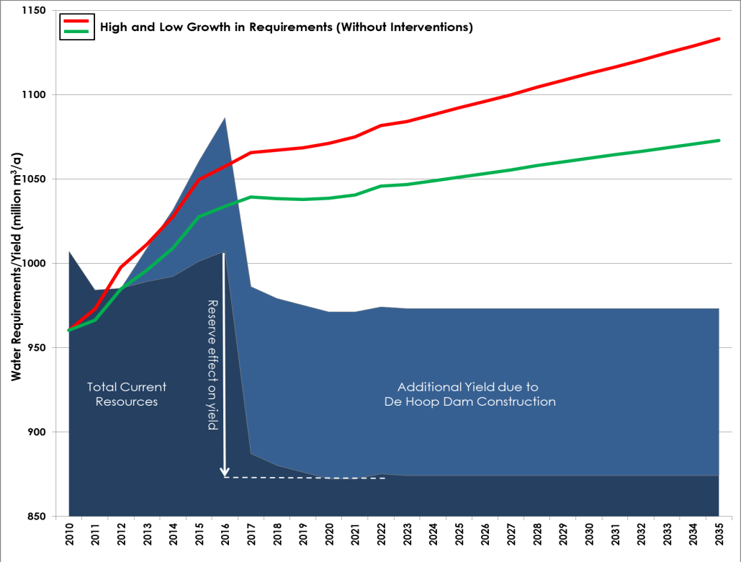
Olifants Reconciliation Strategy
Figure 3-1: Projected Water Balance for whole Olifants Water Supply System
(with no further water resource development after De Hoop)

Slide 8
ACTIONS 1. Update On the Reconciliation Scenarios
Olifants Reconciliation Strategy
Water Requirement scenarios
Individual dam balances
Risk analysis
Revised schedule of interventions
Addressing uncertainties and aspects that may influence the reconciliation scenarios

Slide 9
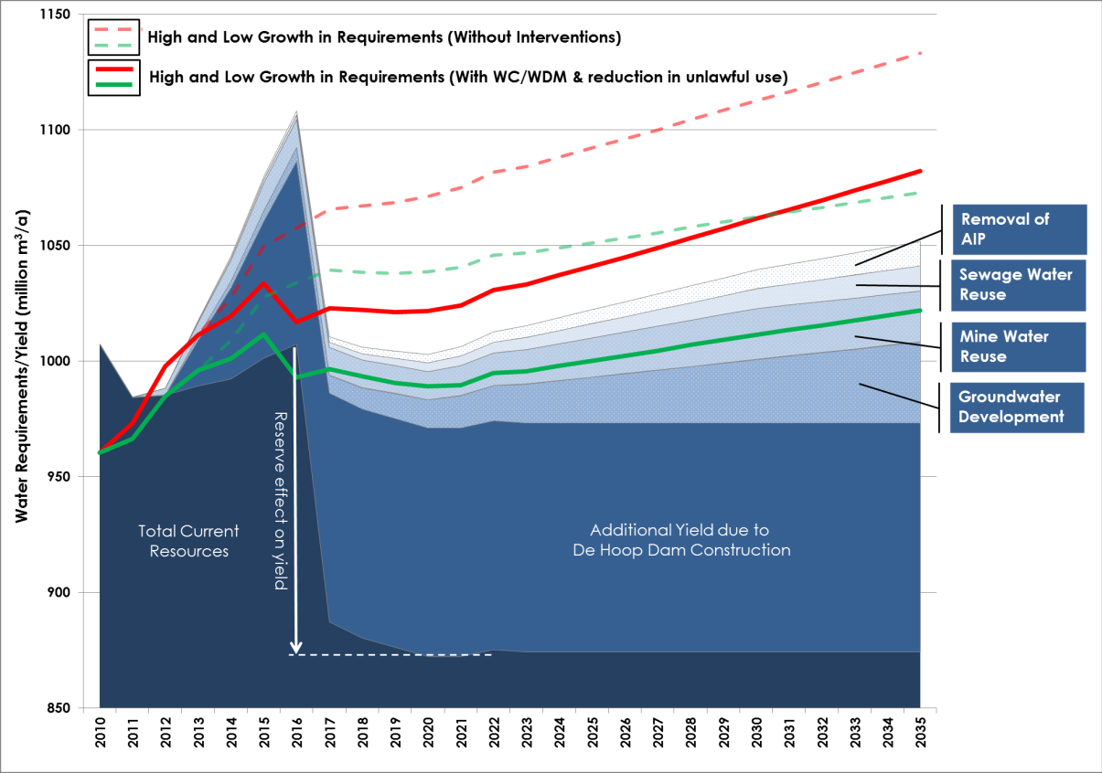
Olifants Reconciliation Strategy
Figure 3-2: Projected Water Balance for whole Olifants Water Supply System
(50% Intervention Success scenario – Meeting Low Growth Projections )

Slide 10
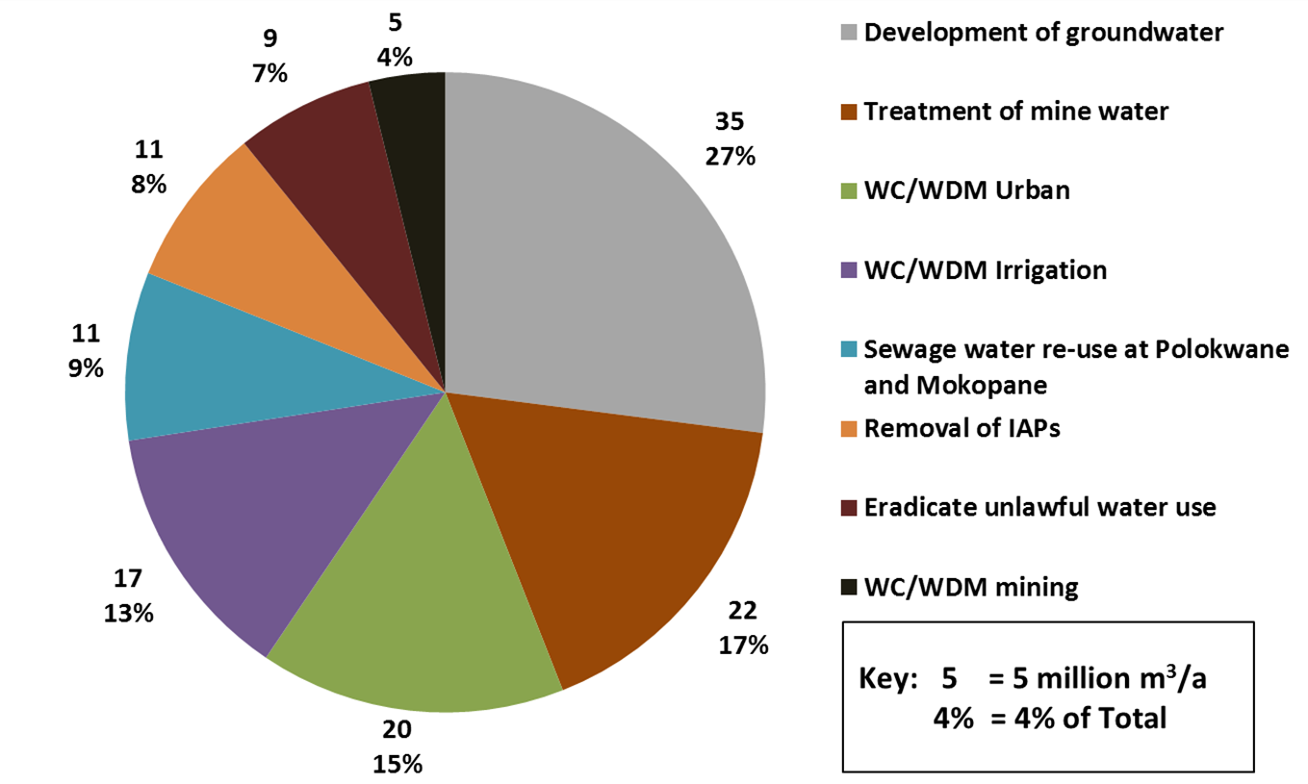
Olifants Reconciliation Strategy
Figure 3-3: Estimated saving/increase in resources for all Strategy Interventions
(50% Intervention success scenario)

Slide 11
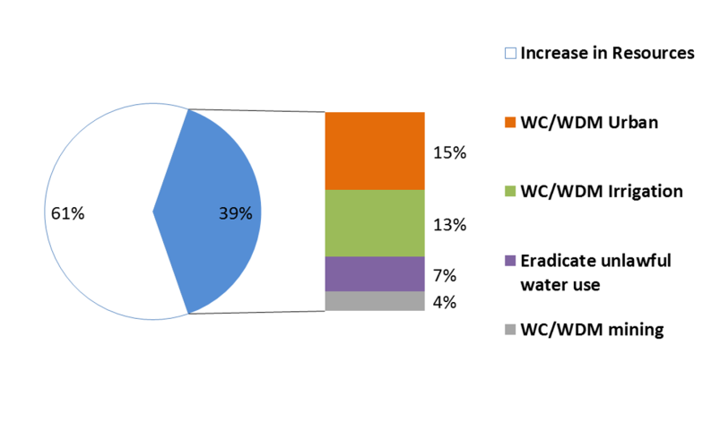
Olifants Reconciliation Strategy
Figure 3-4: % Contribution of requirement reduction interventions to total water
balance (50% Intervention success scenario)

Slide 12
Olifants Reconciliation Strategy
ACTIONS
2. Confirm Institutional Responsibilities

Slide 13
Olifants Reconciliation Strategy
Thank You

